Slide 1
Unit 4: NIMS Coordination: Emergency Operations Centers
Unit 4:
NIMS Coordination:
Emergency Operations Centers

Slide 2
Unit Terminal Objective
Explain the attributes and purpose of Emergency Operations Centers.

Slide 3
Unit Enabling Objectives
Explain the functions and structure of the Emergency Operations Center
Explain the direction provided by the Senior Official / MAC Group to the EOC

Slide 4
NIMS Components

Slide 5
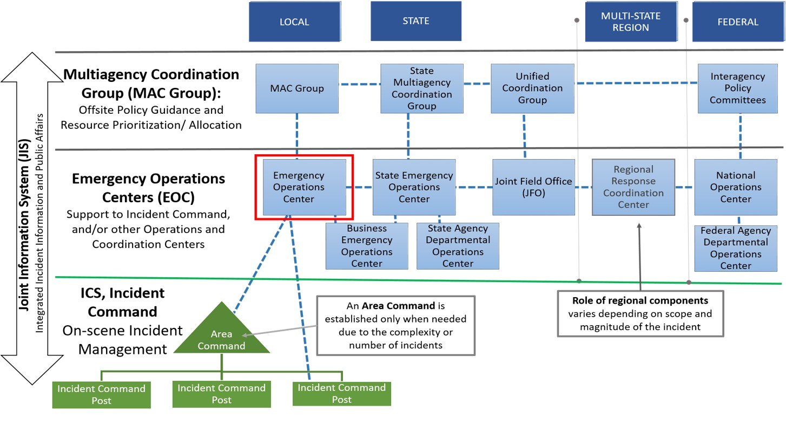
Emergency Operations Centers

Slide 6
EOC Functions
Collecting, analyzing, and sharing information.
Supporting resource needs and requests, including allocation and tracking.
Coordinating plans and determining current and future needs.
Coordinating plans to support the Incident Command.
In some cases, providing coordination and policy direction.

Slide 7
EOC Organizational Structure
While EOCs have common functions, their structure will vary between jurisdictions.
Three common EOC organizational models:
ICS or ICS-Like
Incident Support Model
Departmental.
Jurisdictions or organizations may choose to use one of these structures, a combination of elements from different structures, or an entirely different structure.

Slide 8
EOC Benefits
Helps establish a shared situational picture.
Simplifies information verification.
Facilitates long-term operations.
Increases continuity.
Provides ready access to all available information.
Aids resource identification and use.

Slide 9
EOC and the SR Official/ MAC Group
Local statutes or delegations of authority may limit an EOC’s functions or actions.
Example: Monetary spending thresholds
A SR Official/ MAC Group may:
Authorize additional fiscal resources.
Provide operational guidance.
Oversee complex incidents.
Provide operational or policy guidance.

Slide 10
SR Official/MAC Group Guides the EOC
The actions a Senior Official or the MAC Group may undertake when an EOC is activated for an incident: Issuing an Initial Policy Statement to the EOC.
• Delegating appropriate authority to the EOC Director.
Issuing an Initial Policy Statement to the EOC.
Determining EOC reporting requirements.
Determining the Senior Official/MAC Group decision-making process.
Identifying fiscal issues and possible parameters for the EOC.
Defining strategic level priorities for the incident.

Slide 11
Objectives Review
What are the functions and structure of the Emergency Operations Center?
What direction is provided by the Senior Official / MAC Group to the EOC?

